Slide 1
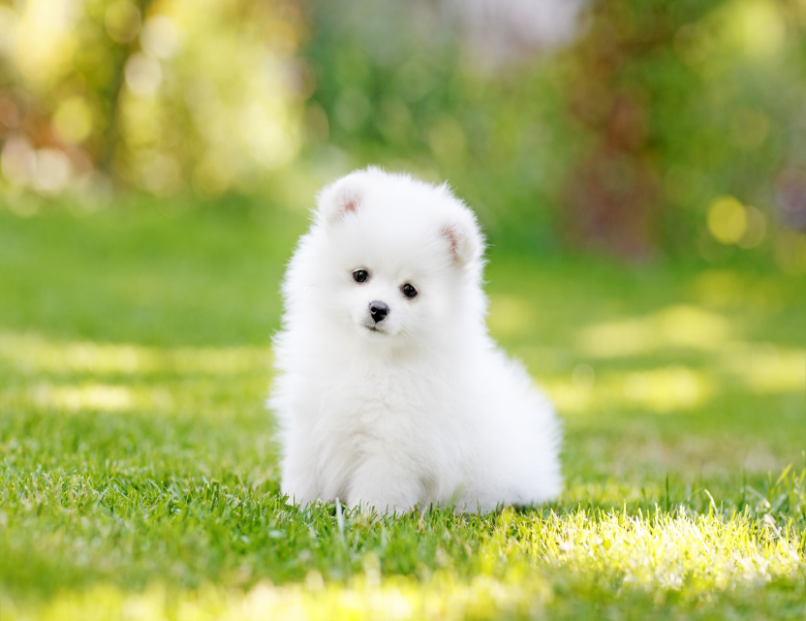
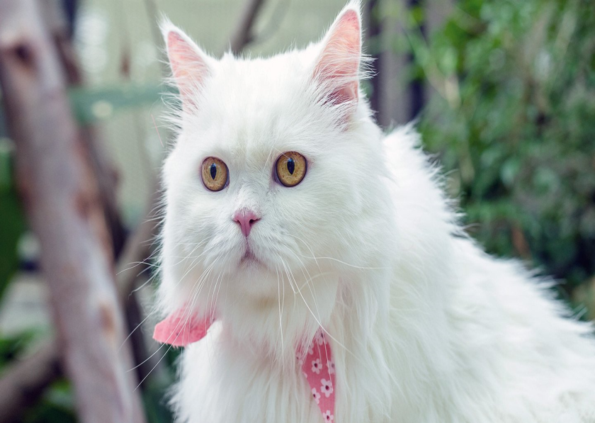
Aural Hematoma in Dogs and Cats

Slide 2
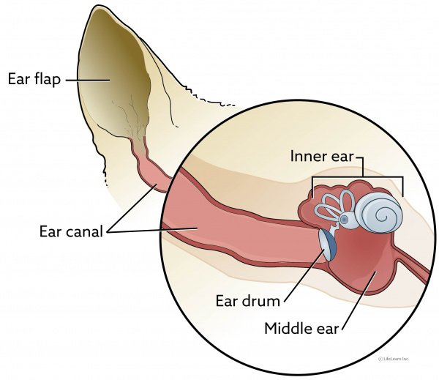
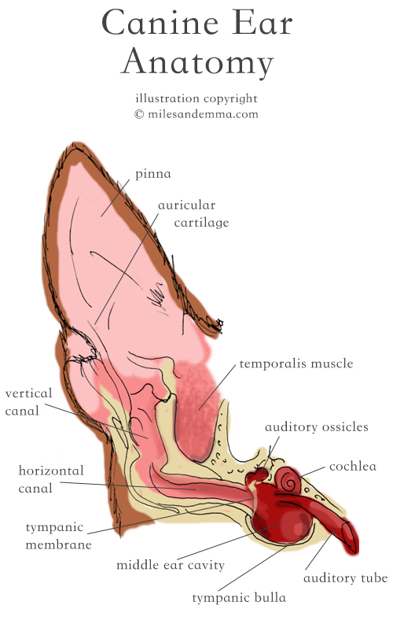
Anatomy of The Ear

Slide 3
Aural Hematoma
A hematoma is swelling created by a broken
blood vessel after that bleeding has occurred
inside a tissue.
Hematoma in the earflaps(aural hematoma) occur when head shaking breaks a blood vessel within the earflap. The earflap may partially or completely swell with blood. The swelling may be so large that the opening of the ear canal is occluded.

Slide 4
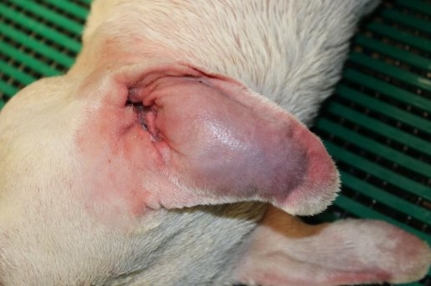
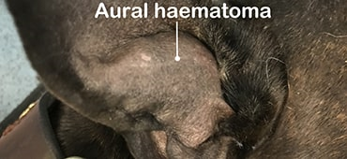

Slide 5
This condition is more common in dogs but can occur in cats as well. The earflap will feel fluctuant and fluid-filled, like a water balloon.
A small hematoma may not actually be a problem and may not require repair.
If The hematoma is so big that the ear canal is occluded (blocked). In this situation, the hematoma must be relieved .

Slide 6
What Do To Relieve Hematoma
There are many ways to correcting ear hematoma:
Aspiration: This procedure simply using a syringe to remove the fluid(blood) from the hematoma. The problem is that a space is left behind when the fluid is removed and this space refills with more fluid leading to only temporary results. The benefits of the aspiration method are that it is inexpensive and relatively easy but the disadvantages are that it may introduce infection and may require multiple attempts.

Slide 7
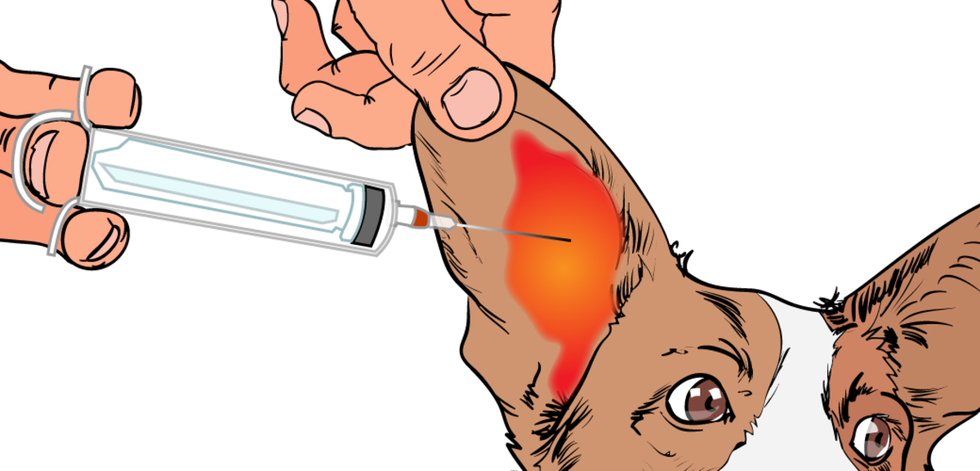
Aspiration

Slide 8
Pie-Crusting Sutures:
An incision is made in the earflap surgically. The hematoma is drained of fluid and blood clots. To prevent the hematoma from refilling with fluid, multiple sutures are placed in the hematoma area either vertically or horizontally, either partly or completely through the earflap, with or without ear cartilage removal.
Note:
If left alone, an ear hematoma will resolve by itself. The fluid will be re-absorbed back into the body and the earflap will no longer bulge.

Slide 9
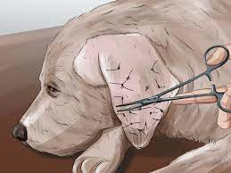
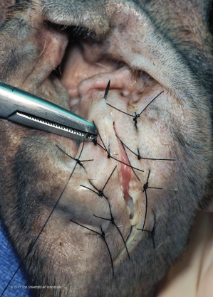
Pie-Crusting Sutures

